Slide 1
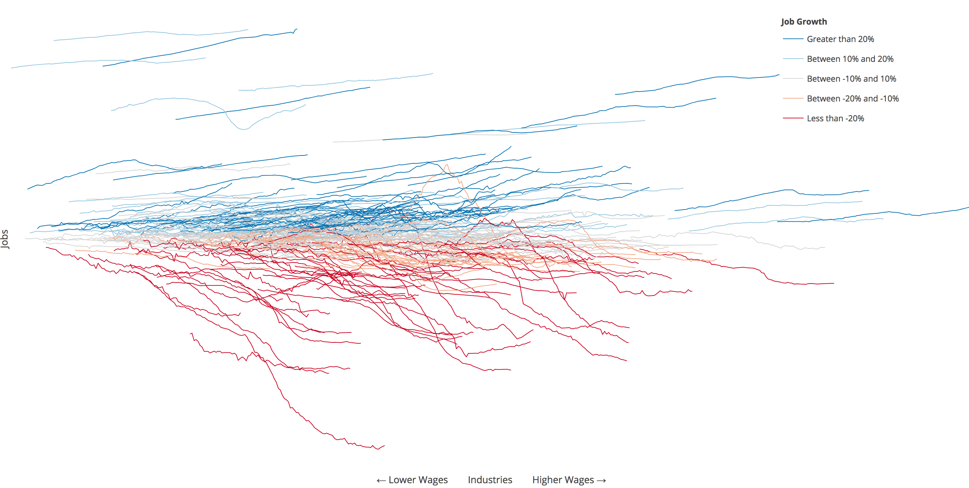
Using Data Analytics to Understand (and Solve) Problems
David Yakobovitch
david@yakobovitch.com

Slide 2
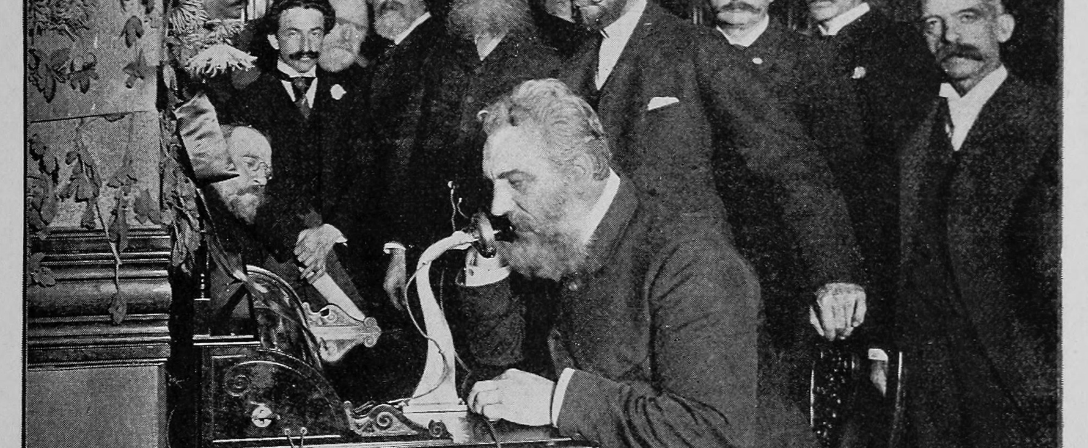
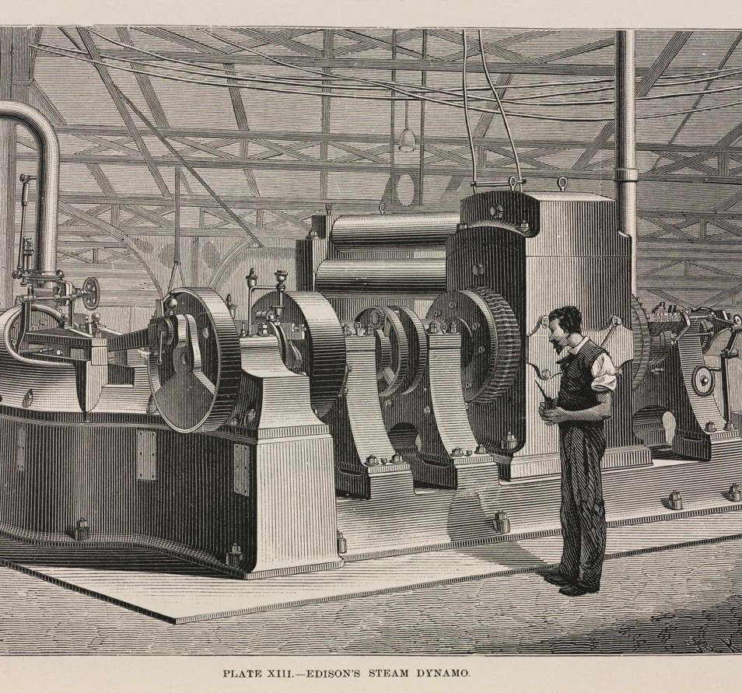
Projects
That Matter
1887
1892

Slide 3
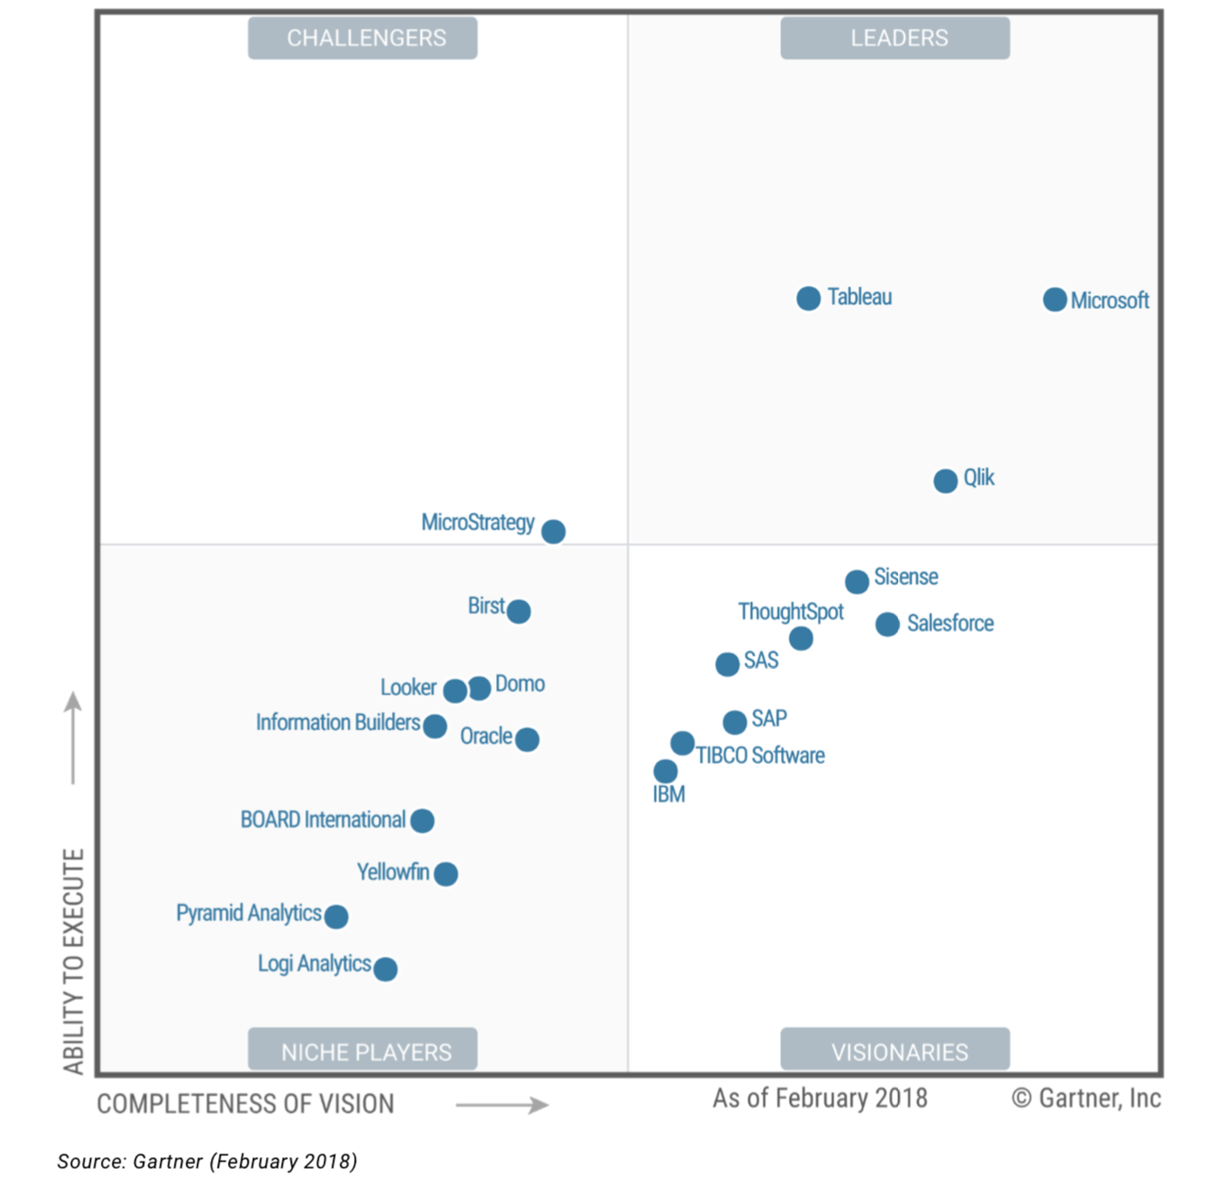
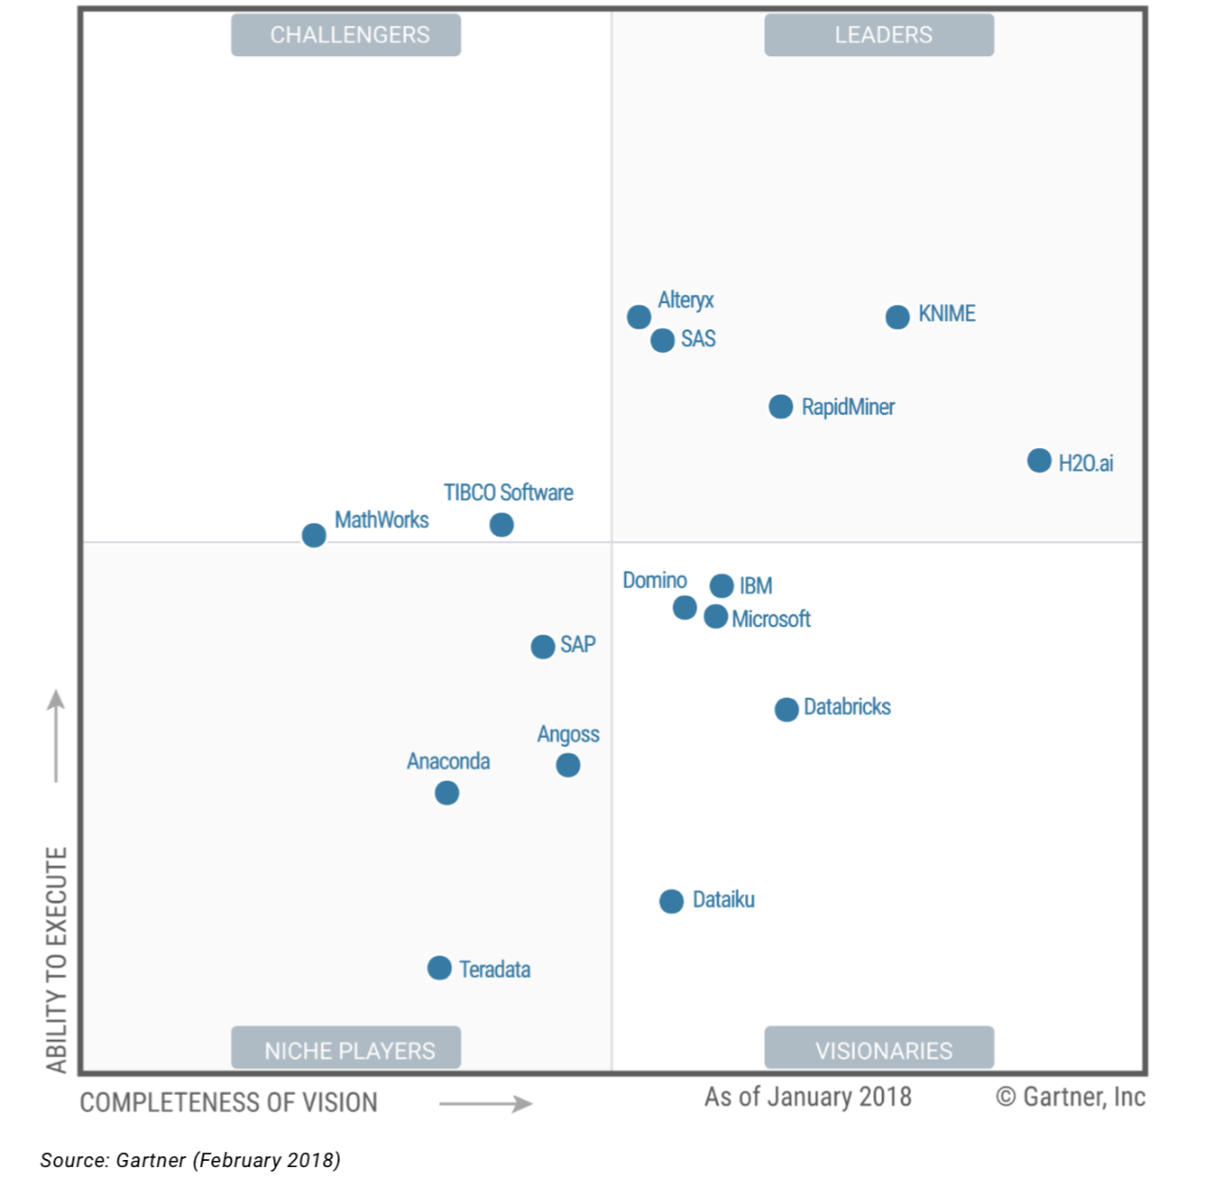
S
T
Gartner Magic Quadrants

Slide 4

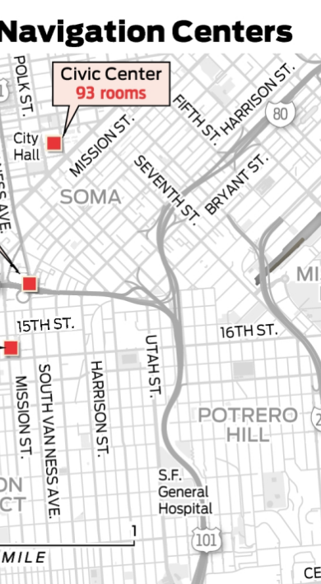


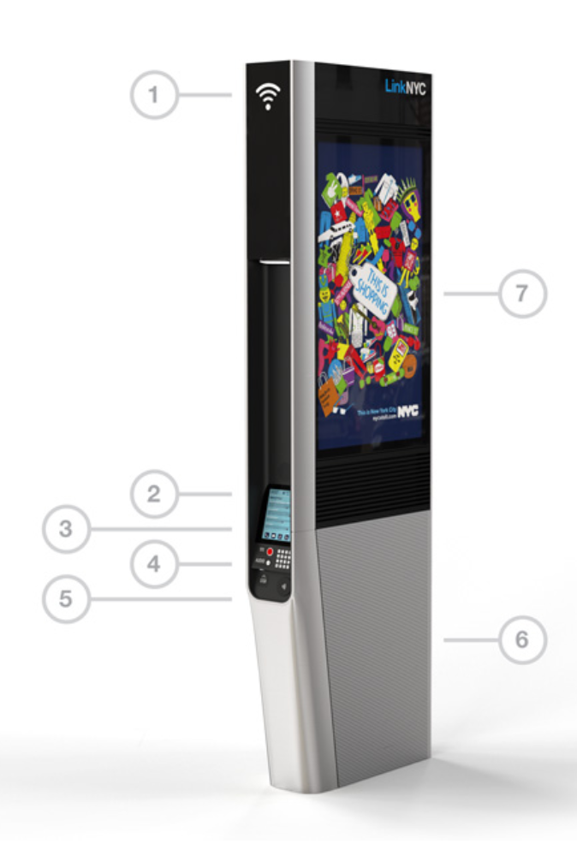

Break
throughs
Across all industries

Slide 5
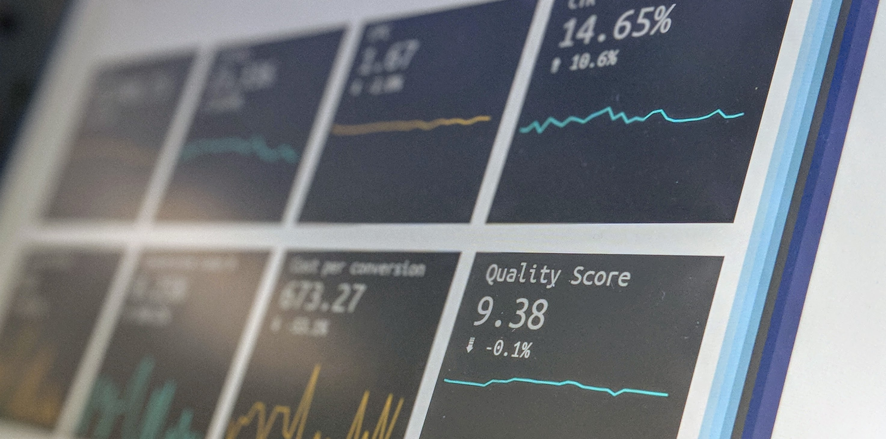
Data First
Yesterday
Today

Slide 6

One
Artificial intelligence
Self-learning at or above human level

Slide 7

Two
Machine learning
Learning with human assistance

Slide 8

Three
Data science
Scientific method applied to data

Slide 9
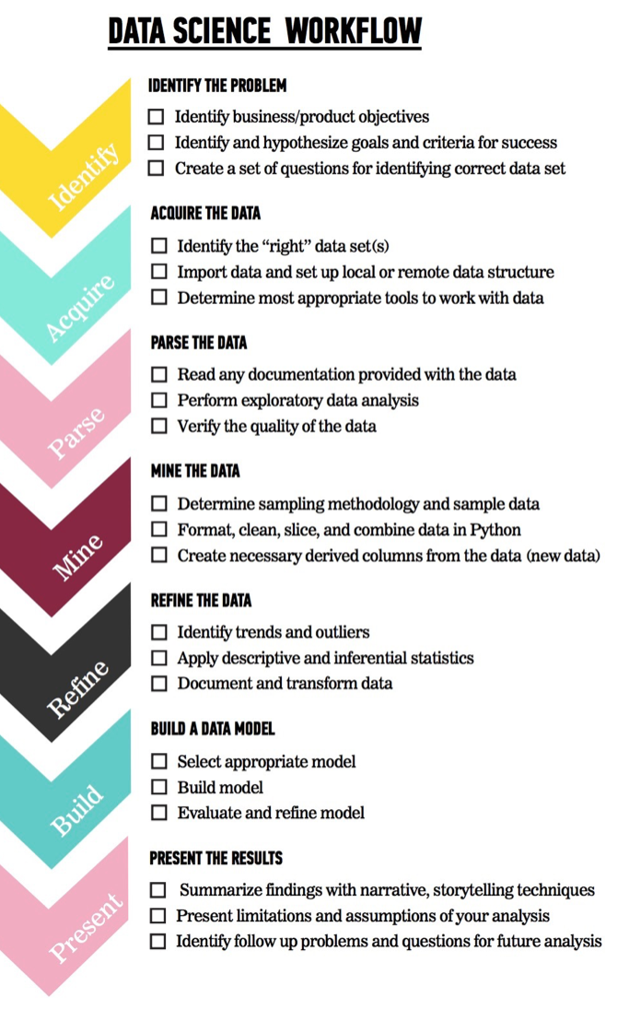
Start
here

Slide 10
Individual Exercise
What challenges are your
organization experiencing?

Slide 11
IRT Scoring (1 to 10)
How impactful will this challenge be to your organization and community?
How much will this improve your organizational readiness?
How time sensitive is this goal for your organization to achieve in the next 6 months?

Slide 12
Rank your challenges
Add all 3 numbers.
Which ranked the highest?
How close was second?
Third?

Slide 13
SMART Goals: Independent
Specific: What will you accomplish?
Measurable: By how much will you increase?
Actionable: With what method will you grow?
Realistic: How plausible is this growth hack to achieve?
Timely: By when will you accomplish this goal?
Increase bed usage.
Vs.
By November 2, 2018, increase bed occupancy to 90% at all 3 satellite locations through text message alerts with our 5,000 veterans.

Slide 14
SMART Goals: Demo Workshop
Specific: What will you accomplish?
Measurable: By how much will you increase?
Actionable: With what method will you grow?
Realistic: How plausible is this growth hack to achieve?
Timely: By when will you accomplish this goal?
Increase bed usage.
Vs.
By November 2, 2018, increase bed occupancy to 90% at all 3 satellite locations through text message alerts with our 5,000 veterans.

Slide 15
SMART Goals: Group Share
Specific: What will you accomplish?
Measurable: By how much will you increase?
Actionable: With what method will you grow?
Realistic: How plausible is this growth hack to achieve?
Timely: By when will you accomplish this goal?
Increase bed usage.
Vs.
By November 2, 2018, increase bed occupancy to 90% at all 3 satellite locations through text message alerts with our 5,000 veterans.

Slide 16
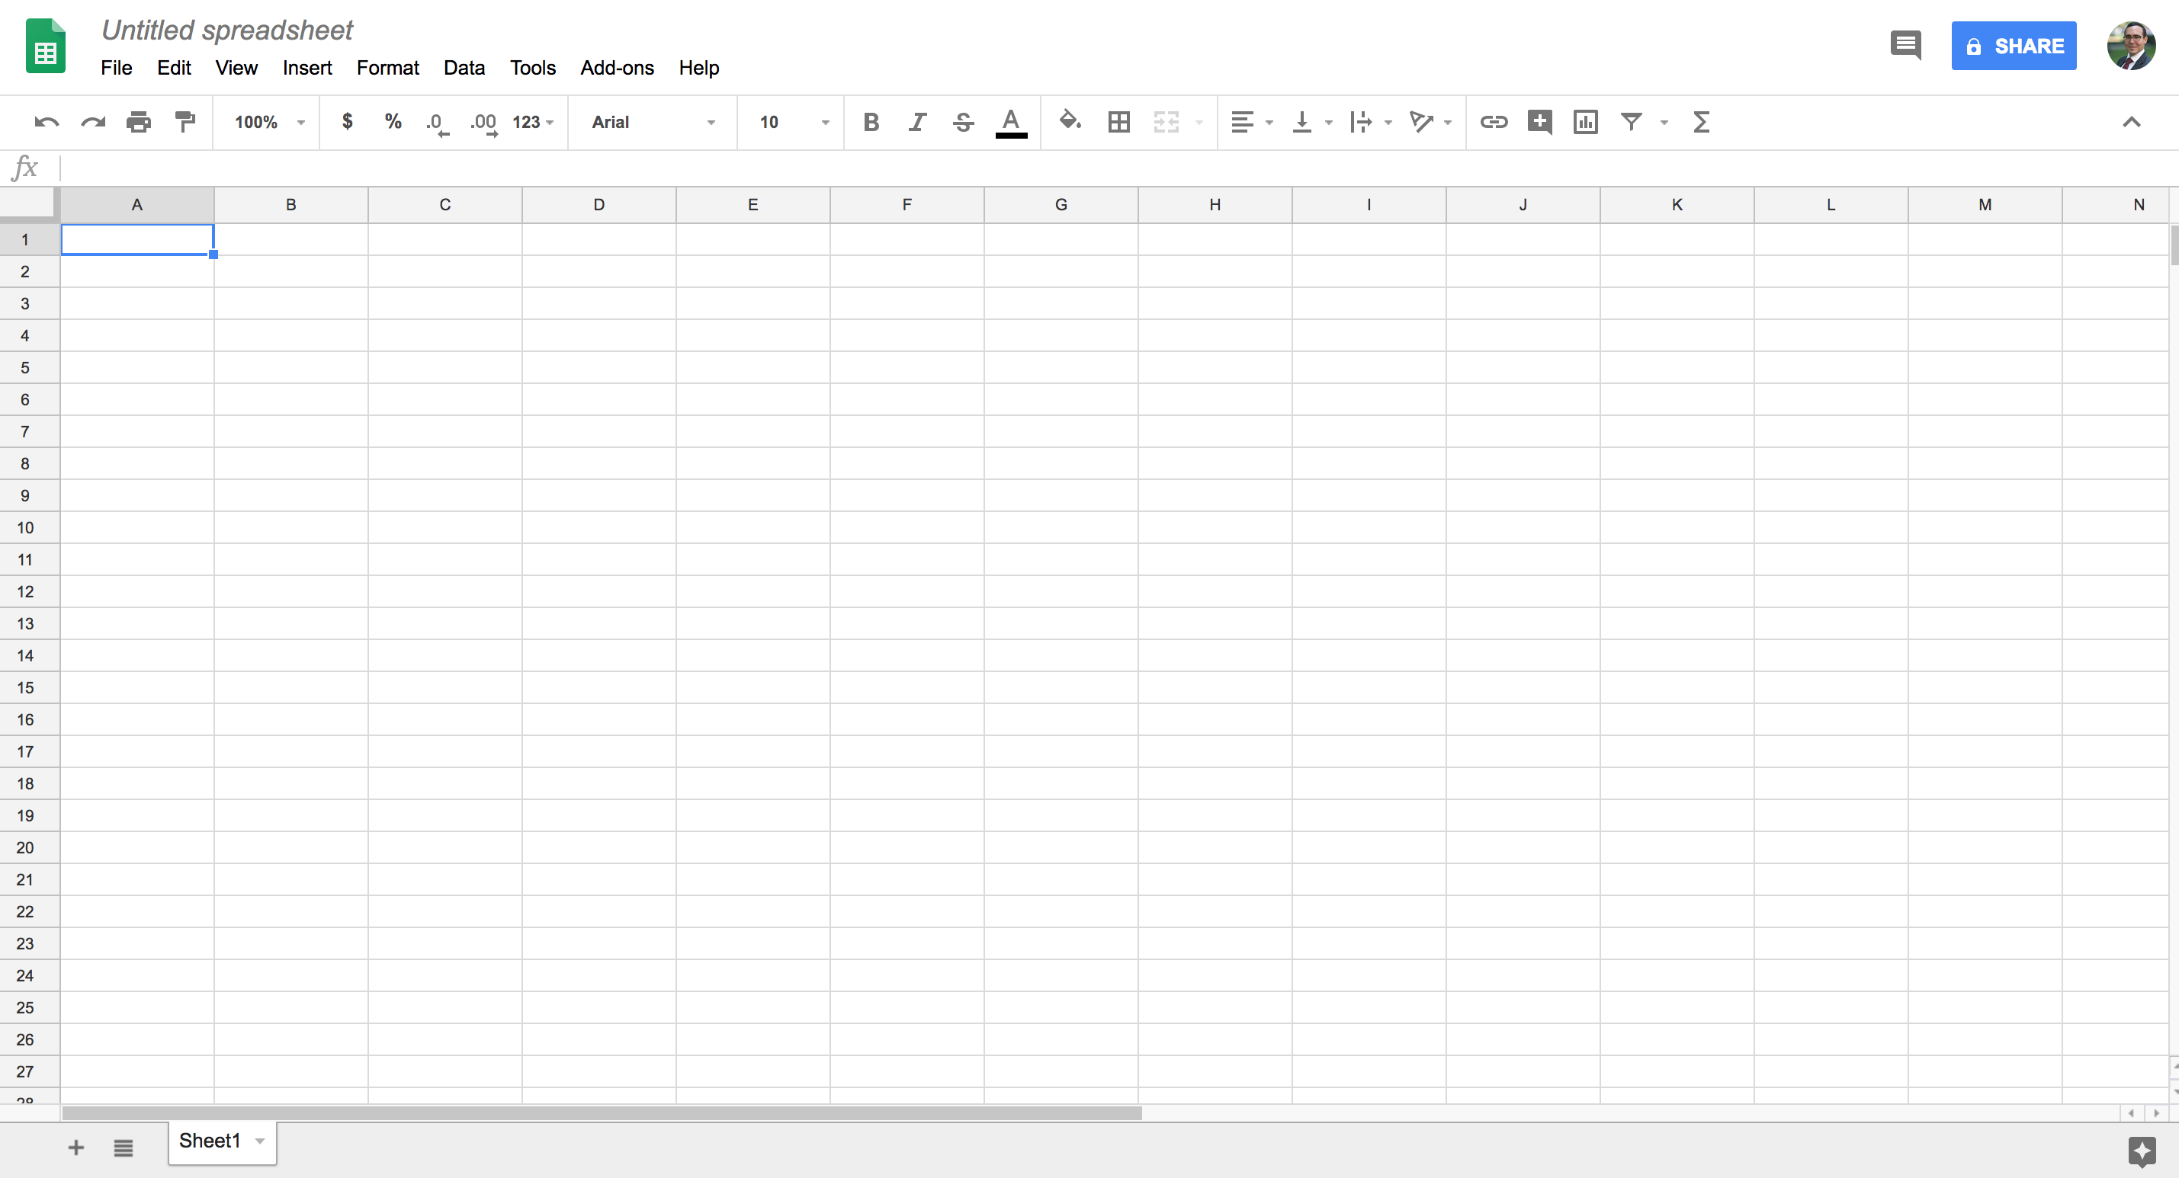
TRACKING YOUR DATA
IN THE CLOUD

Slide 17
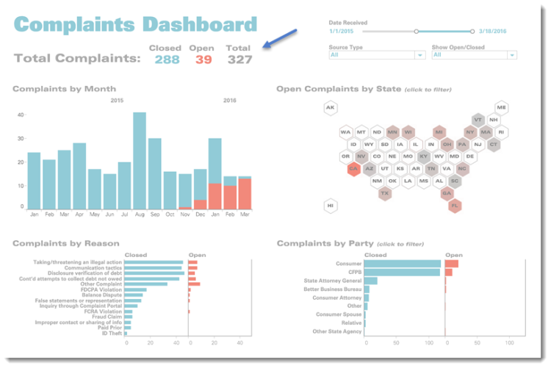
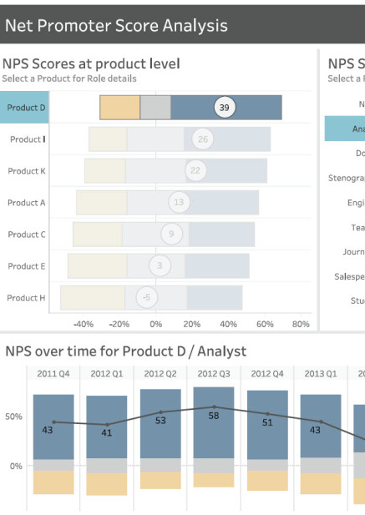
CREATE
DASHBOARDS

Slide 18
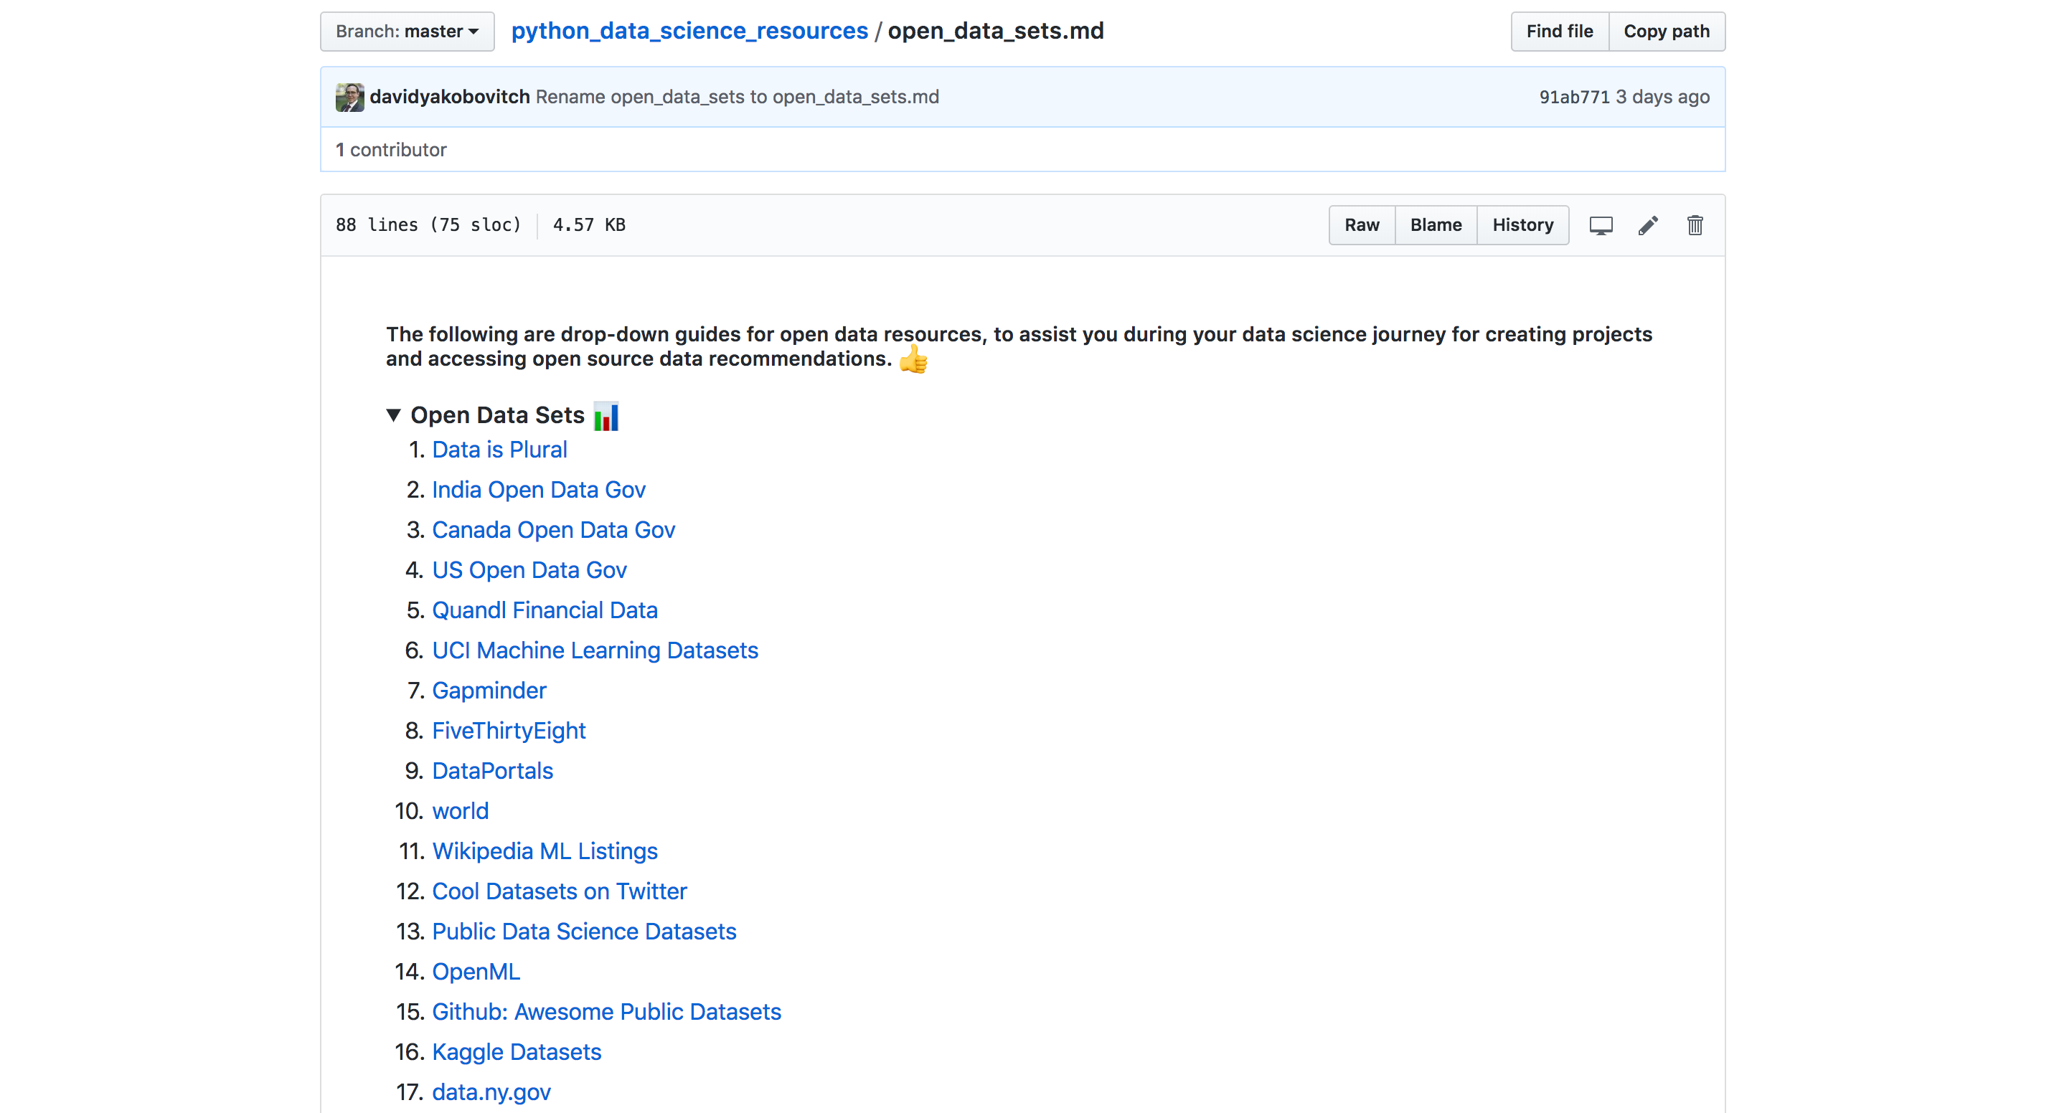
EXPLORE DATA SOURCES

Slide 19
EXPLORE DATA SOURCES
Visit: bit.ly/opendatasets

Slide 20
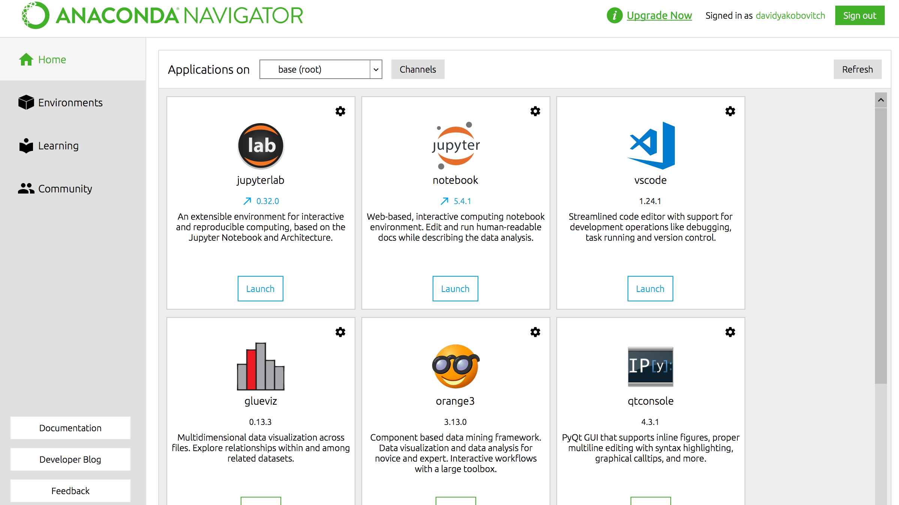
EXPLORE TOOLS FOR DATA

Slide 21
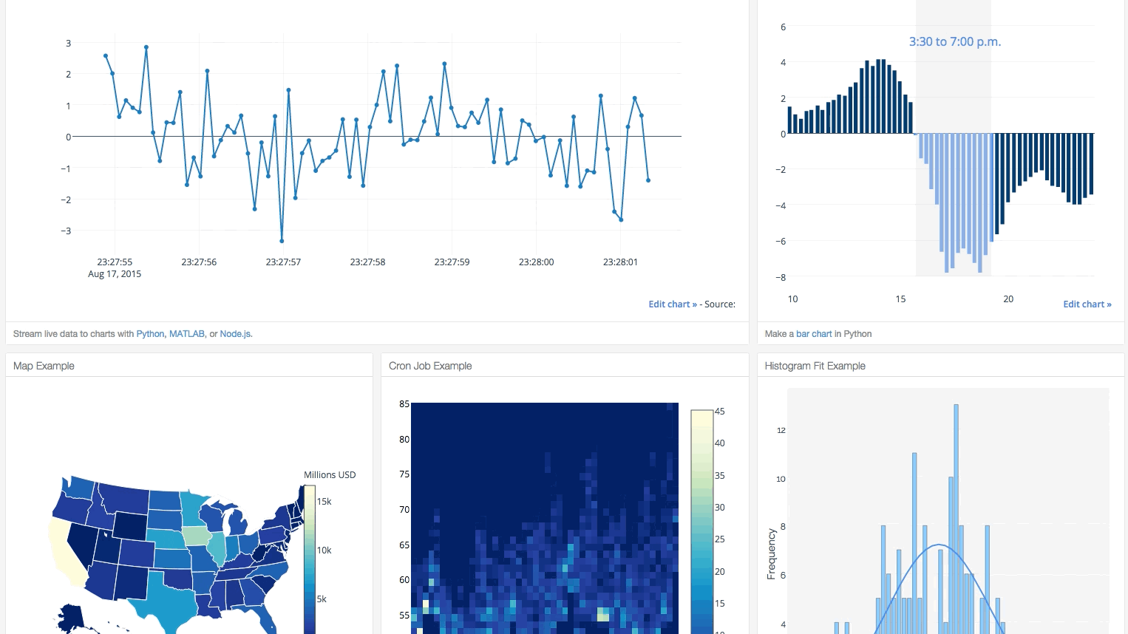
Python Plotly Dash
bit.ly/plotlydash

Slide 22
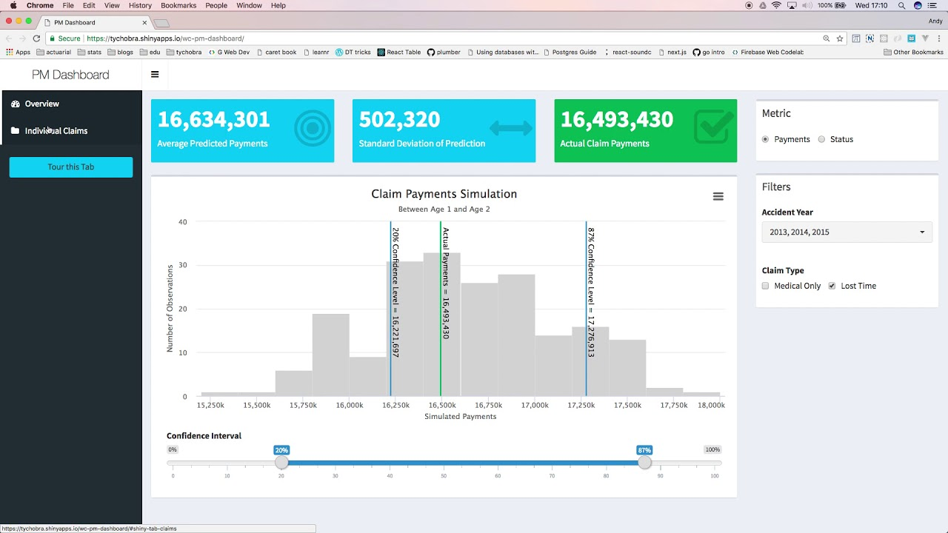
R Shiny Apps
bit.ly/rshinyapp

Slide 23
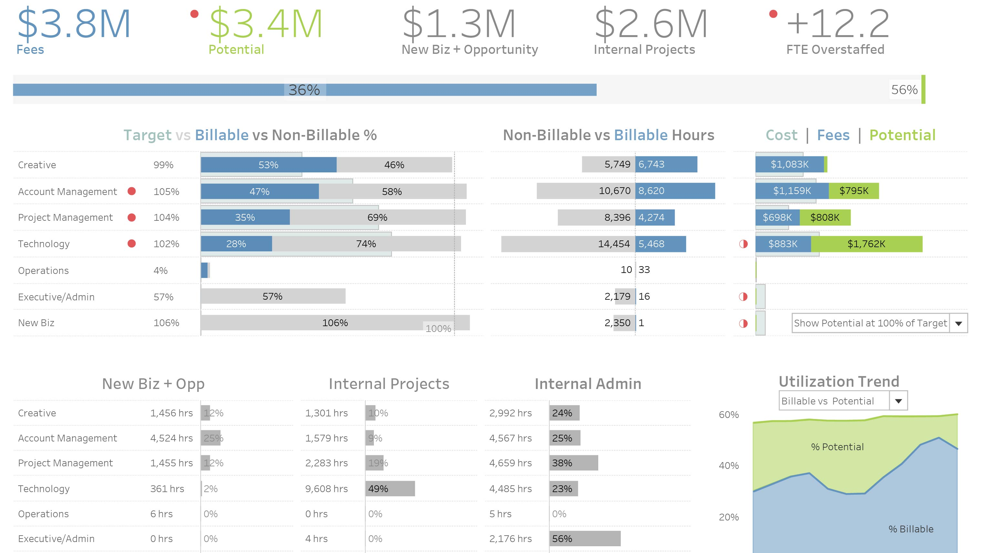
Tableau (Big Book of Dashboards)
bit.ly/bigbookdash

Slide 24
EXPLORE WHAT ARE GOOD GRAPHS?

Slide 25
Power of Visualization

Slide 26
Attributes of Good Visualizations

Slide 27
Attributes of Good Visualizations

Slide 28
Example 1

Slide 29
Example 2

Slide 30
Example 3

Slide 31
Example 4

Slide 32
Example 5

Slide 33
MAKE YOUR WORKFLOW

Slide 34
Continue
here

Slide 35
The 5 steps
01
Identify the problem
What is the challenge you would like to solve? What is the hypothesis and critical goals for success?
02
Acquire the data
Identify the right data sets and tools to work with. Read documentation and review the data.

Slide 36
The 5 steps
01
Identify the problem
What is the challenge you would like to solve? What is the hypothesis and critical goals for success?
02
Acquire the data
Identify the right data sets and tools to work with. Read documentation and review the data.
03
Refine the data
Clean the data and add calculations to better explain and understand your data.
04
Build data models
Whether visualizations, or data science models, explore the insights and trends that you can reveal from your data.
05
Communicate your results
Create a dashboard, a report, or a presentation to share the outcomes with both your internal and external stakeholders

Slide 37
SHARE YOUR WORKFLOW

Slide 38
Using Data Analytics to Understand (and Solve) Problems
David Yakobovitch
david@yakobovitch.com

